Slide 1
Sales -- Dashboard 1
File created on: 2/28/2023 5:44:23 PM

Slide 2
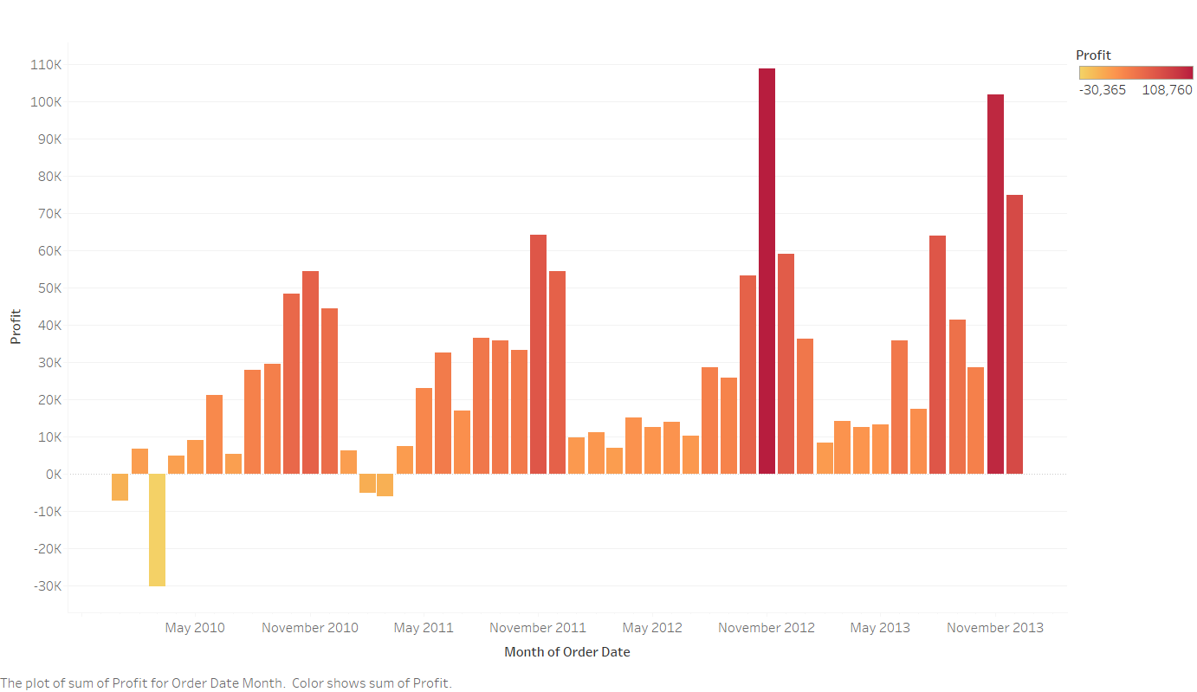

Slide 3
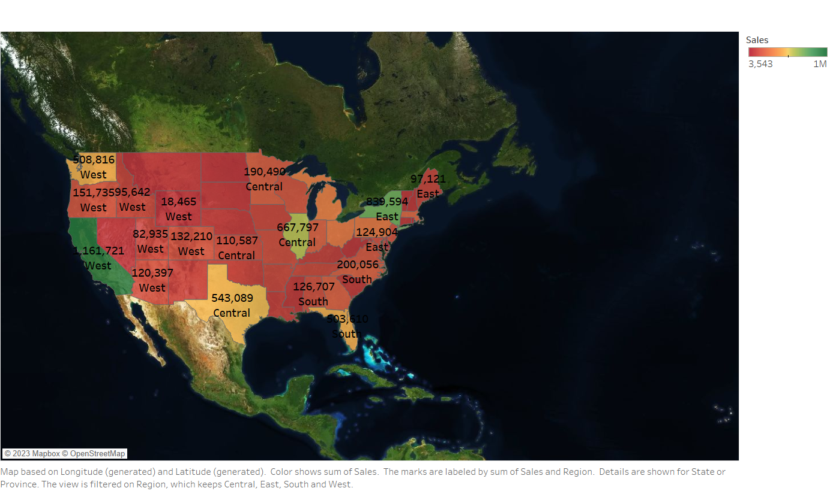

Slide 4
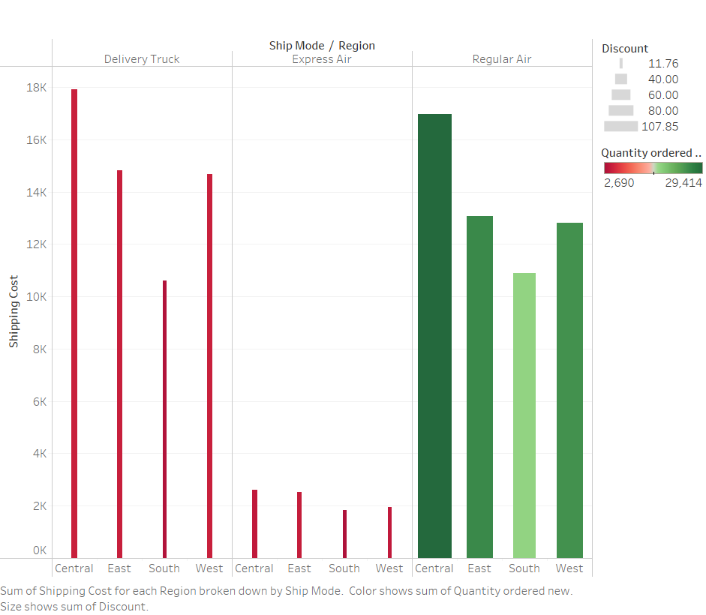

Slide 5
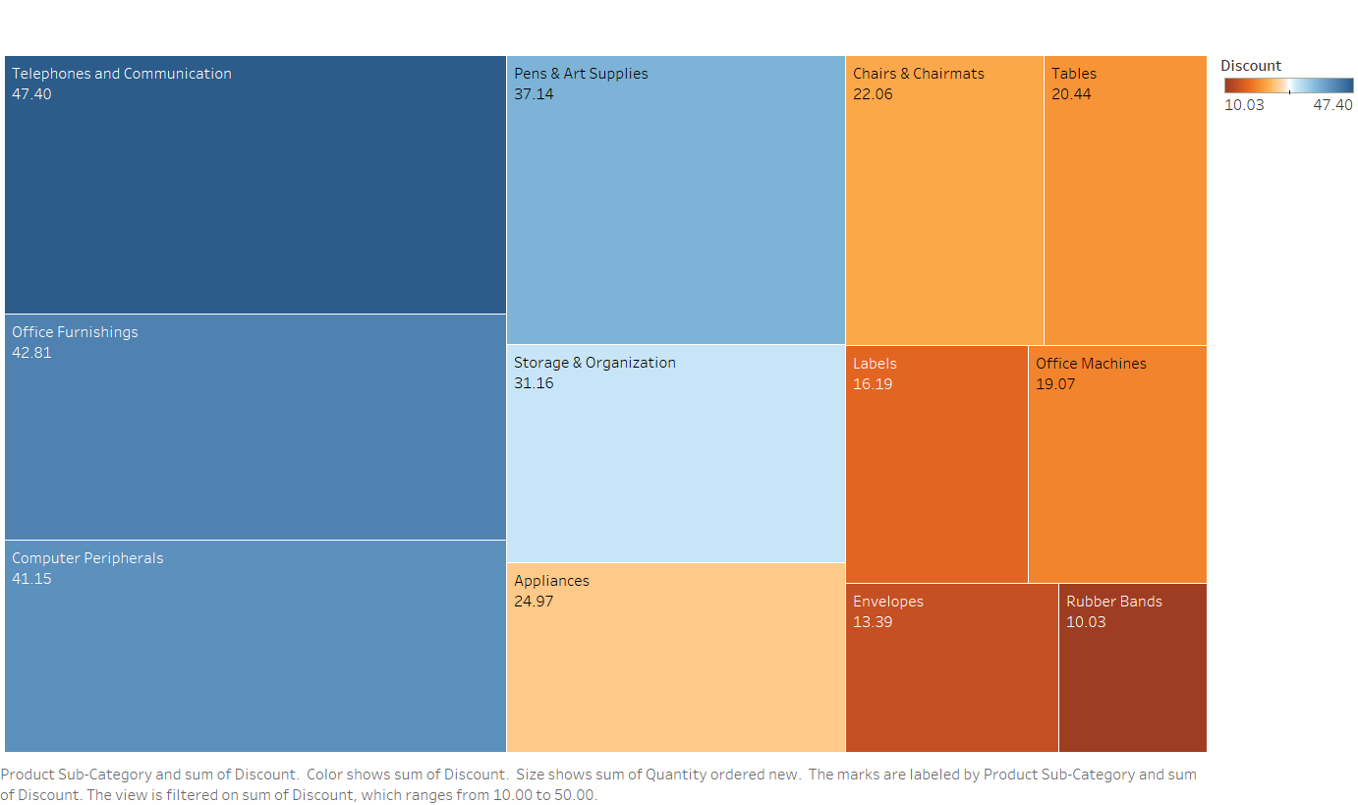

Slide 6
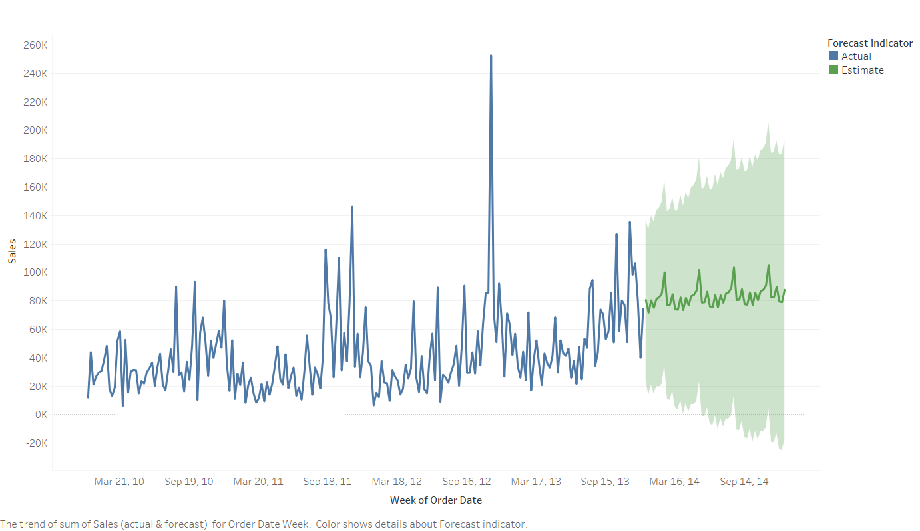

Slide 7
